Slide 1




HackOrbit 2025
Team AARAMBH
Coding the change from AARAMBH to infinity.

Slide 2

THEME:
HEALTHCARE TECH
Problem Statement:
Many rural regions of India, healthcare systems face severe challenges in managing vaccination records and tracking patient immunizations. This results in avoidable health risks and a lack of timely interventions.
Key Challenges:
1. Paper-based records are often lost, damaged, or incomplete
2. Citizens rely solely on health workers for updates—no self-access to records
3. Missed vaccinations, especially for infants, pregnant women, and the elderly
4. No centralized database for rural immunization tracking
5. Poor data availability for planning rural health outreach programs

Slide 3
PROPOSED SOLUTION
1. Creating QR-based digital health cards for each citizen.
2. Offering a mobile-friendly platform for health workers and users.
3. Sending SMS reminders before vaccine due dates.
4. Allowing patient login to view their family’s vaccination records.
5. Helping authorities track coverage village-wise for better planning.

Slide 4
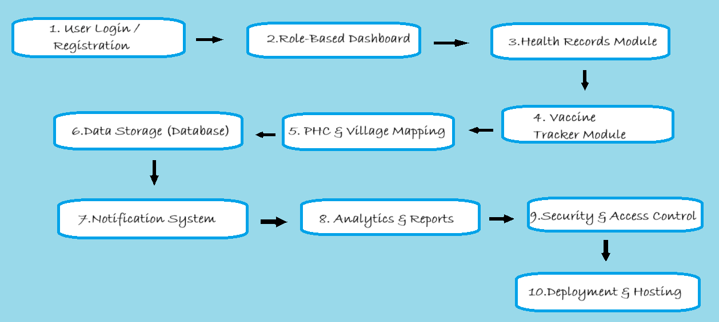
FLOWCHART

Slide 5
DESCRIPTION
A smart, scalable, and accessible web platform designed to digitally transform rural healthcare. It empowers health workers and villagers with:
1. Digitized Health Records 2. Automated Vaccine Tracking & Reminders 3. PHC-Based Patient Mapping 4. Real-Time Health Analytics for Government Monitoring
With a mobile-friendly interface, regional language support, and secure role-based access, our solution ensures inclusive, transparent, and data-driven rural health management — all in one place.

Slide 6
FEATURES AND NOVELTY
CATEGORY | FEATURES | NOVELTY
Access | Role-based login for Health Workers & Patients | Designed for low-tech rural users
Data Entry | Add & update patient profiles | Minimal form fields, mobile-friendly
Scheduling | Auto vaccine schedule generator | Uses age/gender logic, no manual setup
Reminders | SMS alerts before due dates | Sent in regional languages, no app needed
Record Access | QR-based patient health card | Scan to fetch data instantly, even offline-ready
Interface | Mobile-first, low-bandwidth UI | Built for field work on basic phones
Tracking | Dashboard for health workers | Filter by village, missed vaccines
Patients | Family vaccine view under one login | Supports guardian accounts for dependents

Slide 7
DRAWBACKS
1. Internet Dependency
Currently requires internet; can be solved by adding offline support using Progressive Web App (PWA) features.
2.Language Scalability
SMS & UI localization needs expansion; easily scalable using i18n libraries and community translation.
3. Low Digital Literacy
Some users may face difficulties; mitigated through icon-based UI, local language, and potential voice-assist features.
4. Limited Device Access
Not all rural users have smartphones; platform is designed primarily for health workers with optional patient access.
5. Government Adoption Required
Full impact needs official backing; can start with pilots under NGOs or PHCs for validation and partnership.

Slide 8
TEAM AARAMBH
Coding the change from AARAMBH to infinity.
Members:
1.Kapil Patidar
📞6268759888
📧 kapil888patidar@gmail.com
2.Priyanshi Verma
📞7879107926
📧 priyanshiverma781@gmail.com
3.Hariom Patidar:
📞6267134616
📧 Hariompatidar123450@gmail.com
4.Om Vasudev Singh Shekhawat
📞9926857202
📧 omvasudevsinghshekhawat@gmail.com

Slide 9
Thank you

